Slide 1
Downloading ERA5 wind data
WIND RESOURCE DATA
From the Climate Data Store to a CSV file you can use, in ten steps
cds.climate.copernicus.eu
Notes:
This deck walks through getting one year of hourly ERA5 data for a site from the Climate Data Store website. At the end students have a GRIB file that the era5_to_csv notebook turns into a CSV or Excel file.

Slide 2
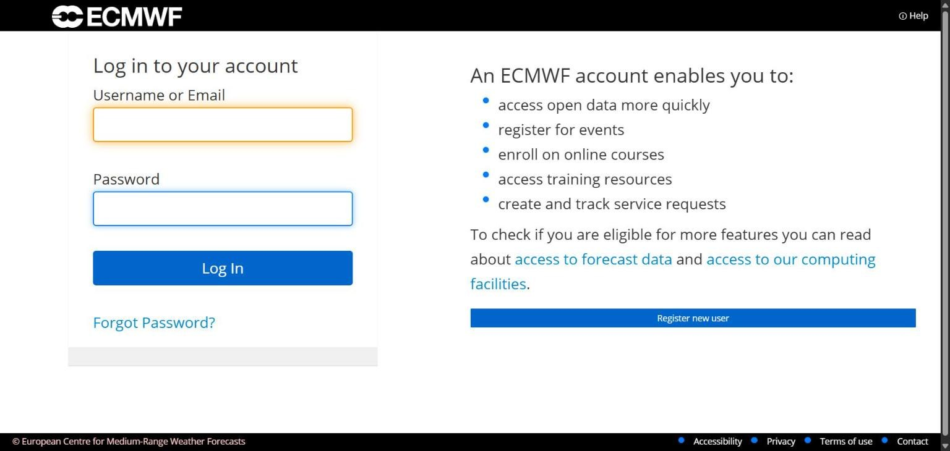
Log in or register
STEP 1 OF 10
Go to cds.climate.copernicus.eu and click Login - Register at the top right.
if you do not have an account, register by Clicking Register new user.
cds.climate.copernicus.eu
Notes:
Everyone needs their own free account. Registration asks for an email confirmation, so students should do this before class.

Slide 3
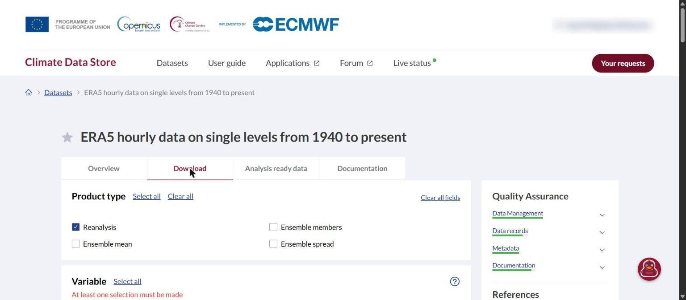
Open the download page
STEP 2 OF 10
Open this link:
cds.climate.copernicus.eu
/datasets/reanalysis-
era5-single-levels
?tab=download
The page should say ERA5 hourly data on single levels, with the Download tab open.
cds.climate.copernicus.eu
Notes:
Give students the link directly. Searching the site lists a similar dataset called ERA5 hourly time-series data first, which is the wrong one.

Slide 4
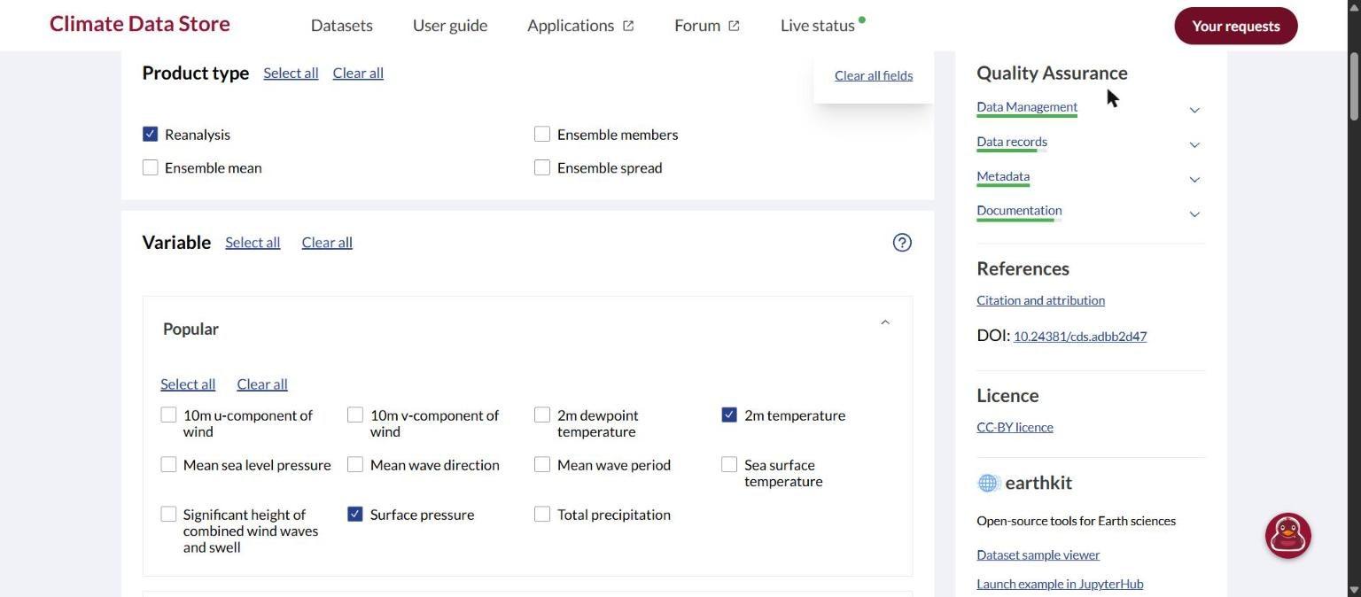
Product type and two variables
STEP 3 OF 10
Product type: Reanalysis. It is ticked already.
Under Popular, tick 2m temperature and Surface pressure.
cds.climate.copernicus.eu
Notes:
The notebook needs exactly four variables. These two are in the Popular group; the two wind variables are in the next step.

Slide 5
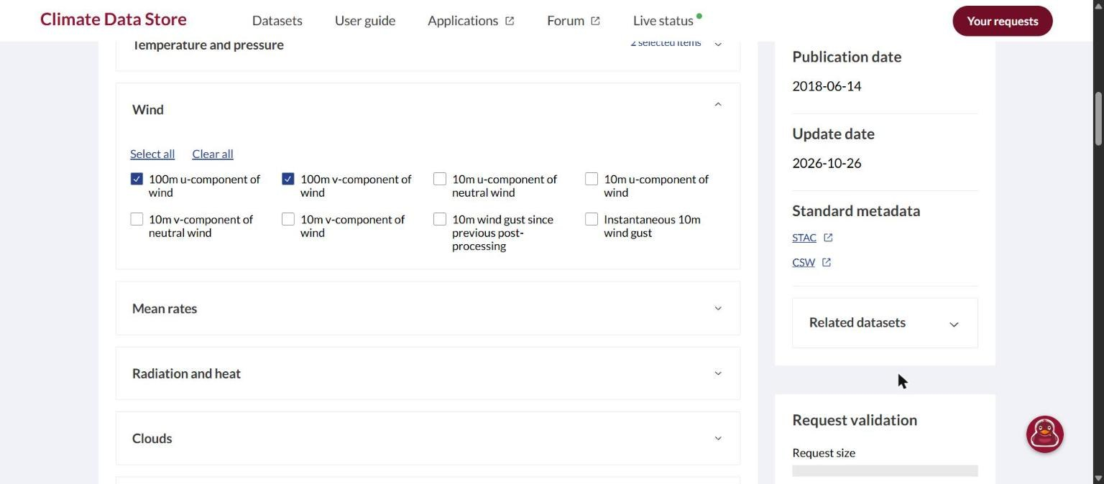
Wind at 100 m
STEP 4 OF 10
Open the Wind group further down.
Tick 100m u-component of wind and 100m v-component of wind.
That makes four variables in total.
cds.climate.copernicus.eu
Notes:
Take the 100 m components, not the 10 m ones. The notebook computes wind speed and direction from these two.

Slide 6
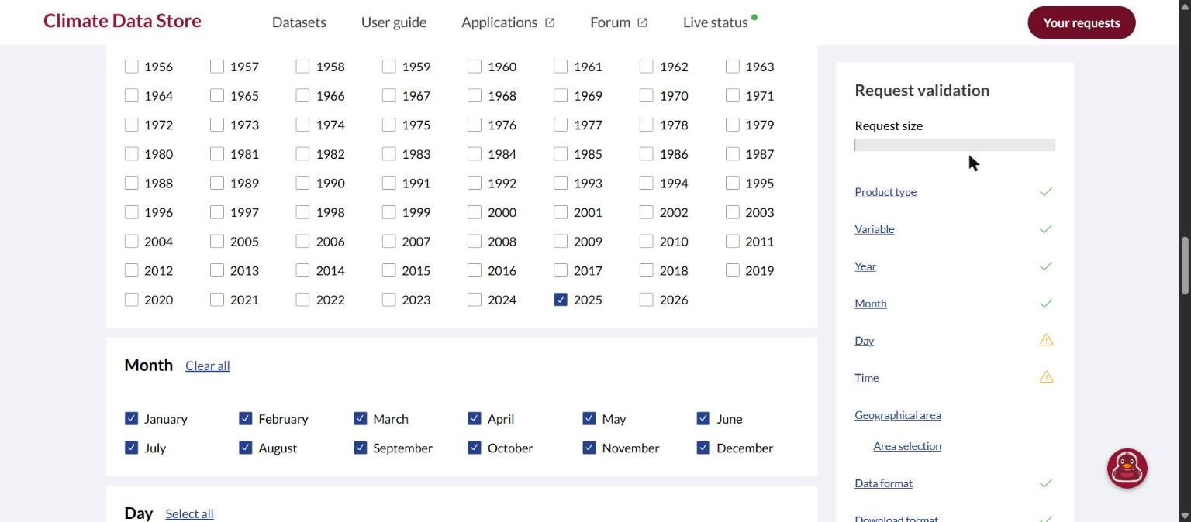
One year, every month
STEP 5 OF 10
Year: tick one year, for example 2025.
Month: click Select all.
cds.climate.copernicus.eu
Notes:
One year per request keeps the download to about 30 minutes. A second year means a second request.

Slide 7
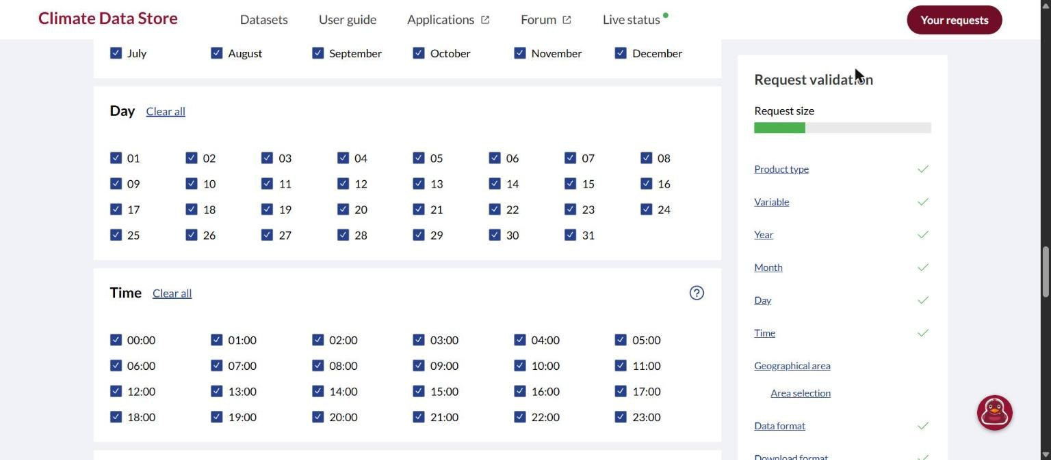
Every day, every hour
STEP 6 OF 10
Day: click Select all.
Time: click Select all.
Dates that do not exist, such as 31 February, are skipped.
cds.climate.copernicus.eu
Notes:
All 24 hours give one row per hour in the CSV: 8760 rows for a normal year.

Slide 8
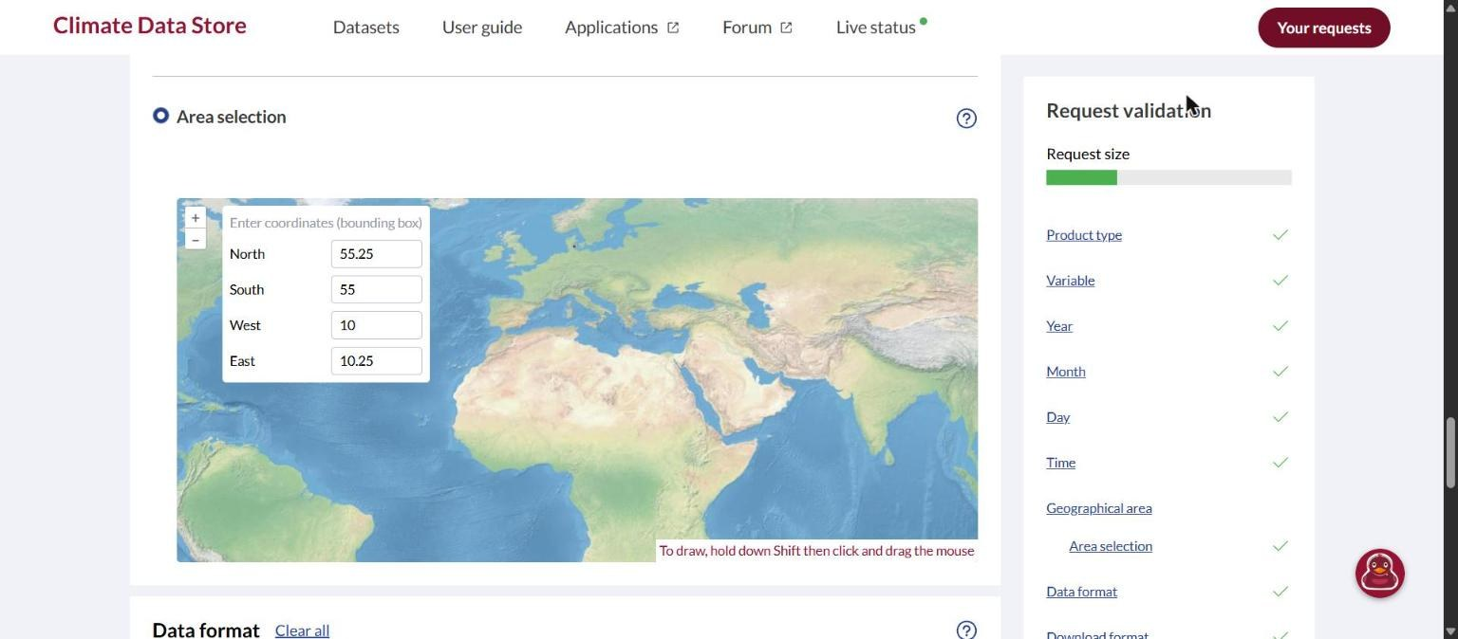
Select the area of your site
STEP 7 OF 10
Choose Area selection. Type the edges of a small box around your site, or hold Shift and drag on the map. For example:
North 55.25
South 55
West 10
East 10.25
Keep the box 0.25° tall and wide. ERA5 has a point every 0.25°, so it holds 4 points.
cds.climate.copernicus.eu
Notes:
The website refuses a box where North equals South or West equals East, so a single point is not possible here. The notebook’s one csv option uses the first point in the file, which is the North-West corner of the box. Use multiples of 0.25 so the corners sit on the ERA5 grid.

Slide 9
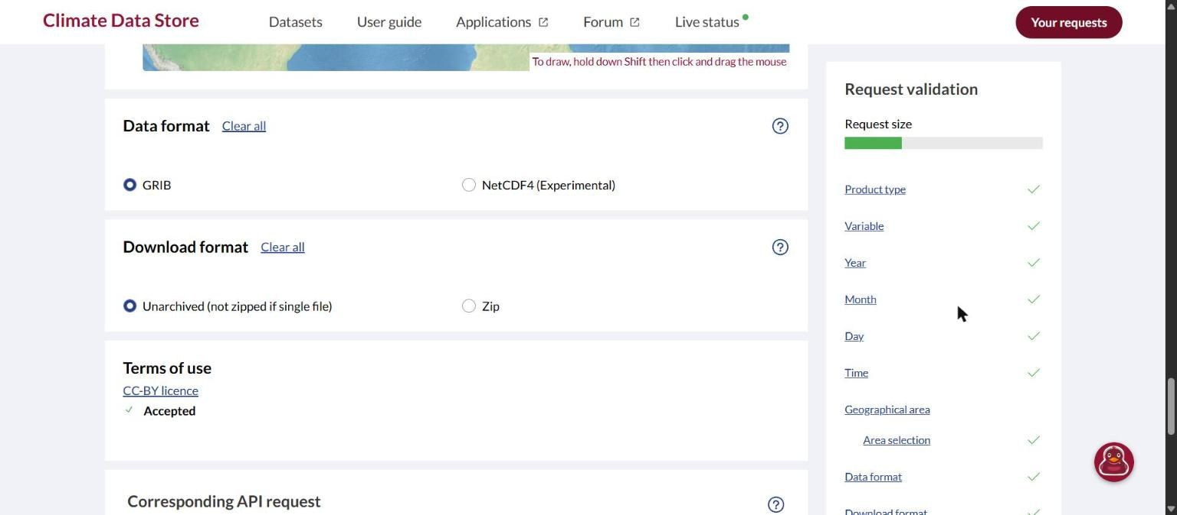
GRIB, unarchived
STEP 8 OF 10
Data format: GRIB.
Download format: Unarchived.
Terms of use: the first time, click Accept terms. After that it says Accepted.
cds.climate.copernicus.eu
Notes:
GRIB and Unarchived are usually selected already. The licence only needs accepting once per account.

Slide 10
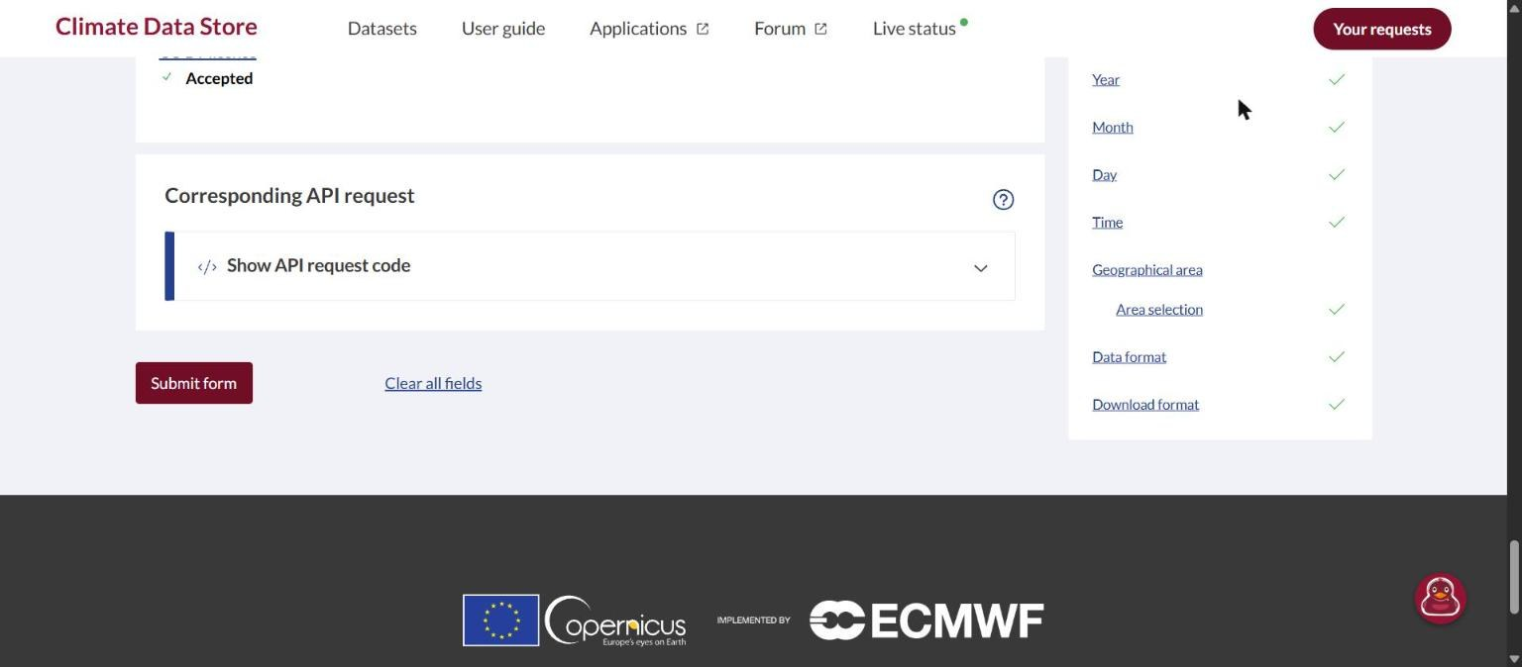
Submit the request
STEP 9 OF 10
Scroll to the bottom and click Submit form.
The request waits in a queue. One year takes about 30 minutes, even for a small box.
cds.climate.copernicus.eu
Notes:
Processing time depends on how many hours are requested, not on the size of the area. Students can close the page; the request keeps running.

Slide 11
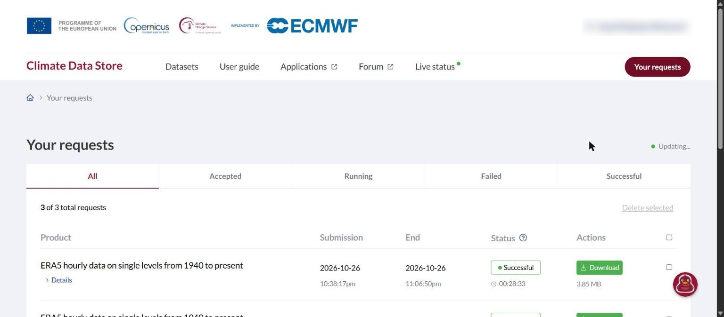
Download the file
STEP 10 OF 10
Click Your requests at the top right.
When the status says Successful, click Download.
You get a .grib file of about 4 MB.
cds.climate.copernicus.eu
Notes:
The file gets a random name such as adbd3f97…grib. Students can keep that name or rename it; either way they paste the name into the notebook.

Slide 12
Checklist for the form
Field | Choose
Product type | Reanalysis
Variable | 2m temperature, Surface pressure, 100m u-component of wind, 100m v-component of wind
Year | One year
Month, Day, Time | Select all
Geographical area | Area selection, a 0.25° box around your site
Data format | GRIB
Download format | Unarchived
cds.climate.copernicus.eu/datasets/reanalysis-era5-single-levels?tab=download
Notes:
A one-page summary students can keep open while filling in the form.

Slide 13
Run the notebook
NEXT
Put the .grib file in the same folder as era5_to_csv.ipynb.
Paste the file name into GRIB_FILE.
Choose OUTPUT_TYPE: "one csv", "many csv" or "excel".
Run all cells. The result is in the output folder.
Notes:
one csv writes the first grid point in the file (the North-West corner of the box). many csv writes one file per grid point, and excel puts each point on its own sheet.

